Slide 1
Enterprise Project Server 2016 Project Online
Hari Thapliyal

Slide 2
Architecture

Slide 3
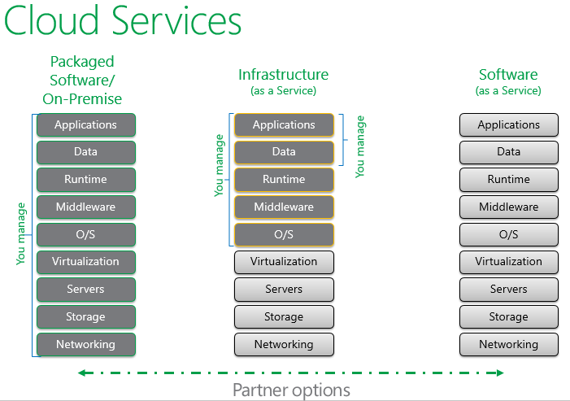
Cloud Services

Slide 4
https://www.youtube.com/watch?v=9OiqJwcqKps&t=524s
https://vedavit.sharepoint.com/sites/pwa/Wiki%20Pages%20Test/Forms/ByAuthor.aspx
https://vedavit.sharepoint.com/sites/pwa/default.aspx
https://vedavit.sharepoint.com/SitePages/Home.aspx
https://vedavit.sharepoint.com/_layouts/15/sharepoint.aspx
https://vedavit-my.sharepoint.com/_layouts/15/MyProjects.aspx
https://office.live.com/start/PowerPoint.aspx?auth=2&s=4&nf=1
https://office.live.com/start/Excel.aspx?auth=2
https://vedavit-my.sharepoint.com/personal/hari_vedavit_onmicrosoft_com
https://protection.office.com/#/homepage
https://vedavit-my.sharepoint.com/personal/hari_vedavit_onmicrosoft_com/_layouts/15/onedrive.aspx
https://portal.office.com/adminportal/home#/homepage
https://www.office.com/1/?auth=2

Slide 5
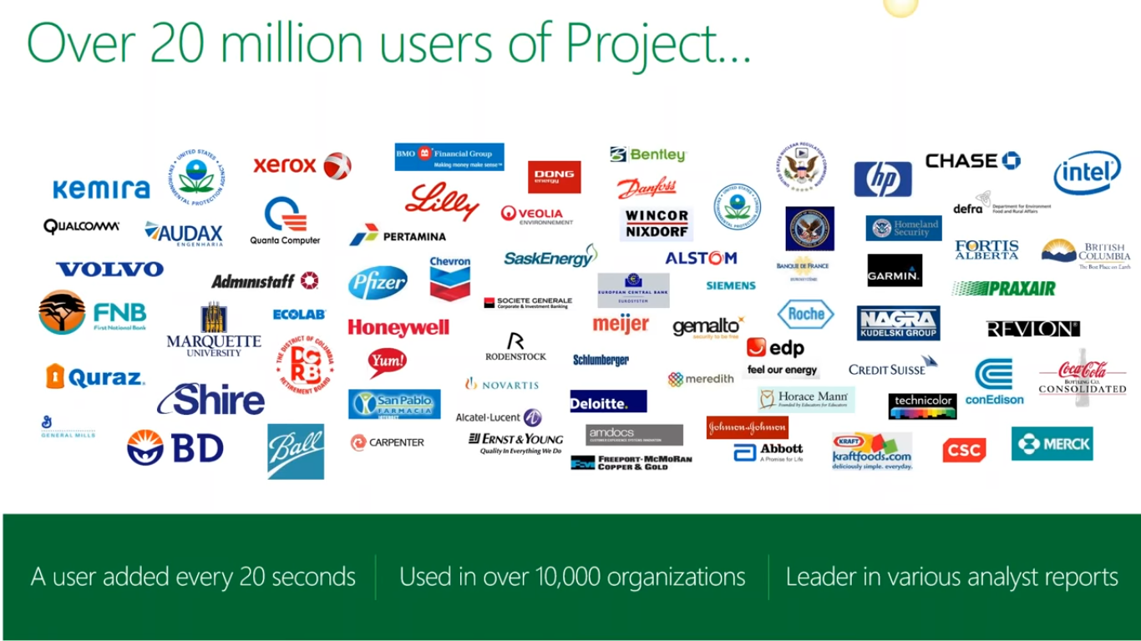

Slide 6
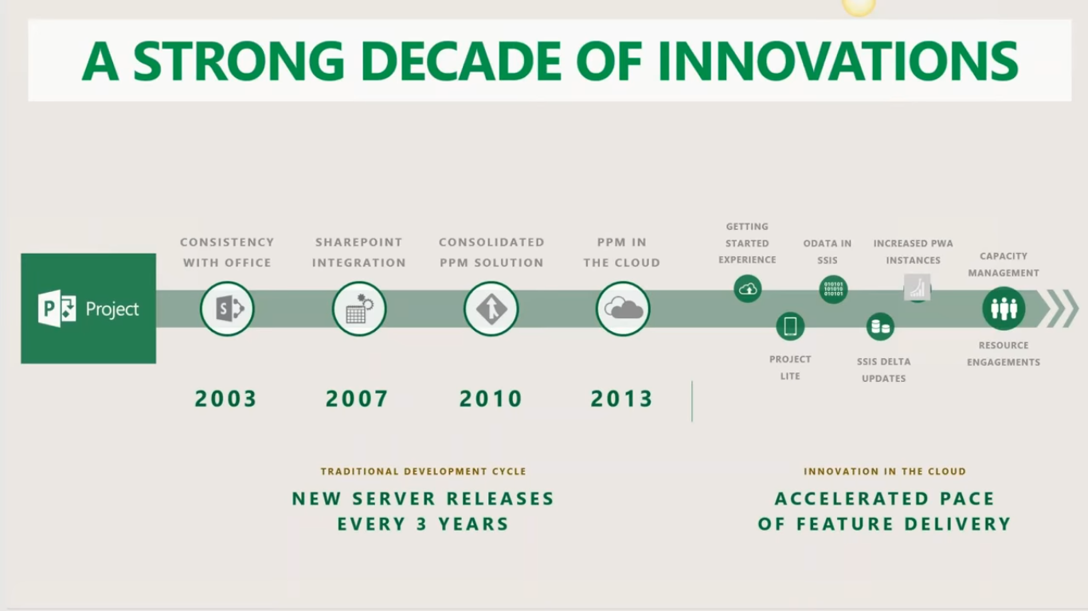

Slide 7
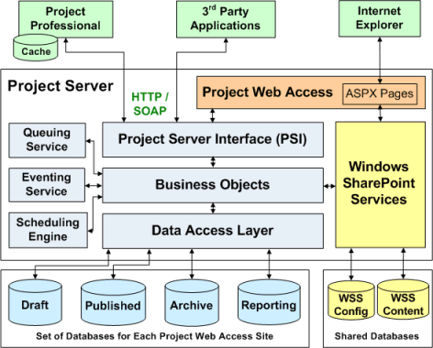
Project Server 2007

Slide 8
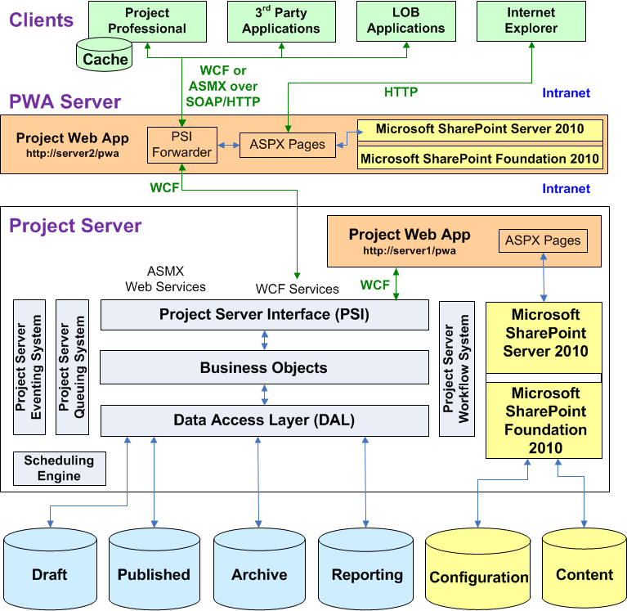
Project Server 2010

Slide 9
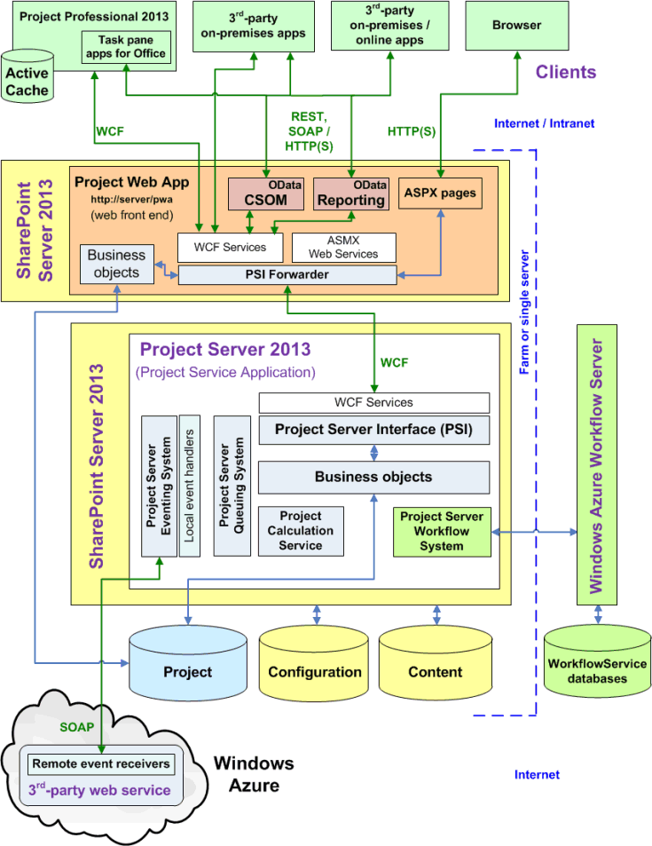
Project Server 2013

Slide 10
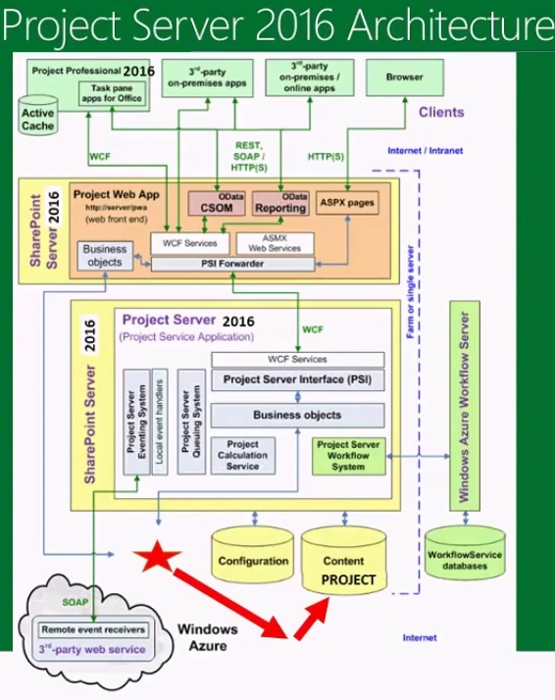
Project Server 2016

Slide 11
Migration and Backup

Slide 12
Project Online: How do I get a copy of my databases?
You have 3 PWA instances available to you so you could use one for testing – but there is no way to get access to your databases or copying them either within or in/out of the datacenters.
as the administrative backup options are not a feature of Project Online
You do of course have access via OData to much of the information in Project Online and could pull this down to a local data store for other reporting purposes. or through CSOM as described in the Project SDK.
The OLAP cubes aren’t an option in Project Online

Slide 13
Configuration

Slide 14
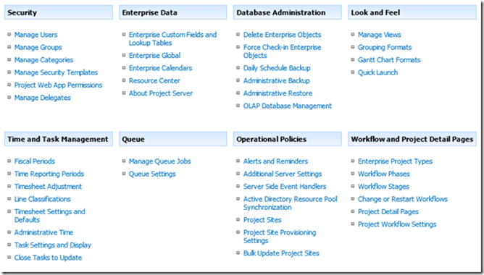
Project Server 2007

Slide 15
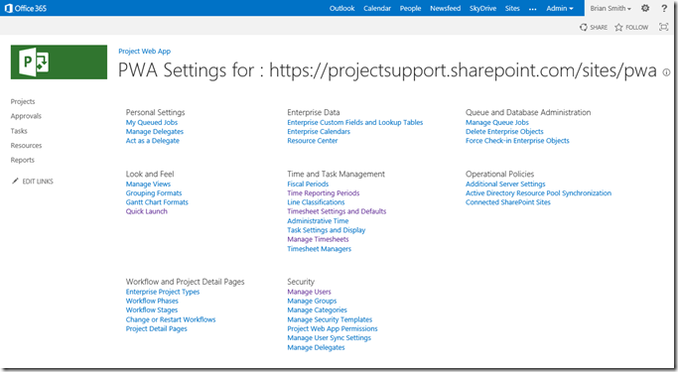
Project Server 2016

Slide 16
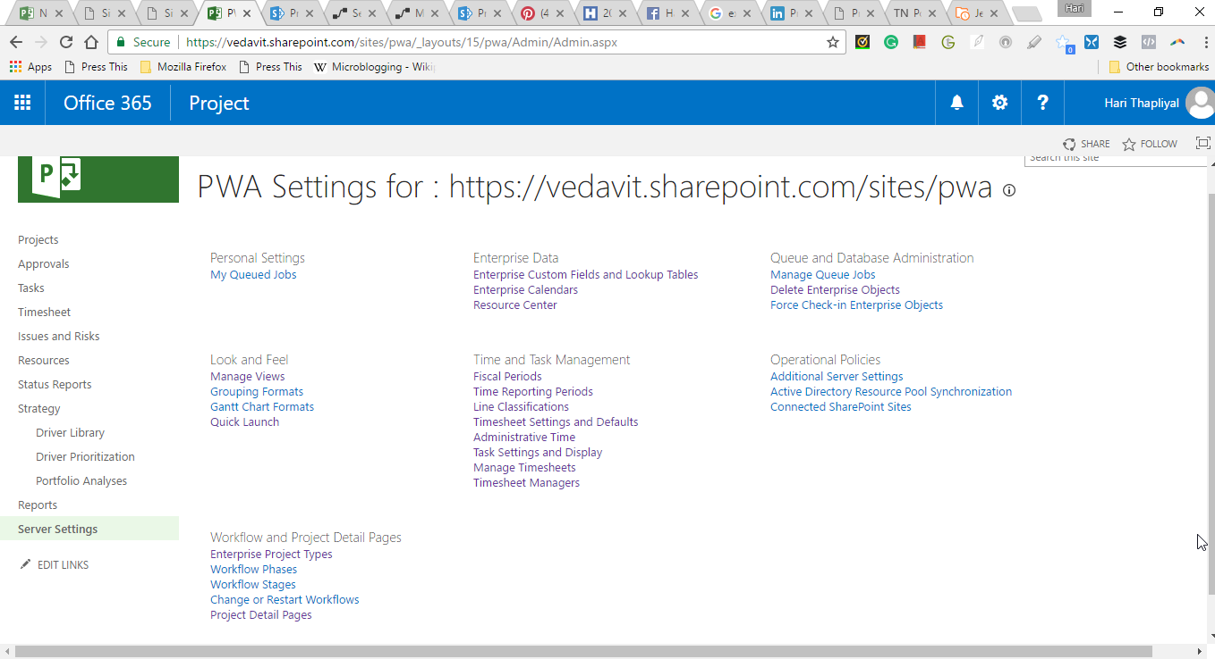
Project Server 2016

Slide 17
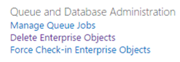
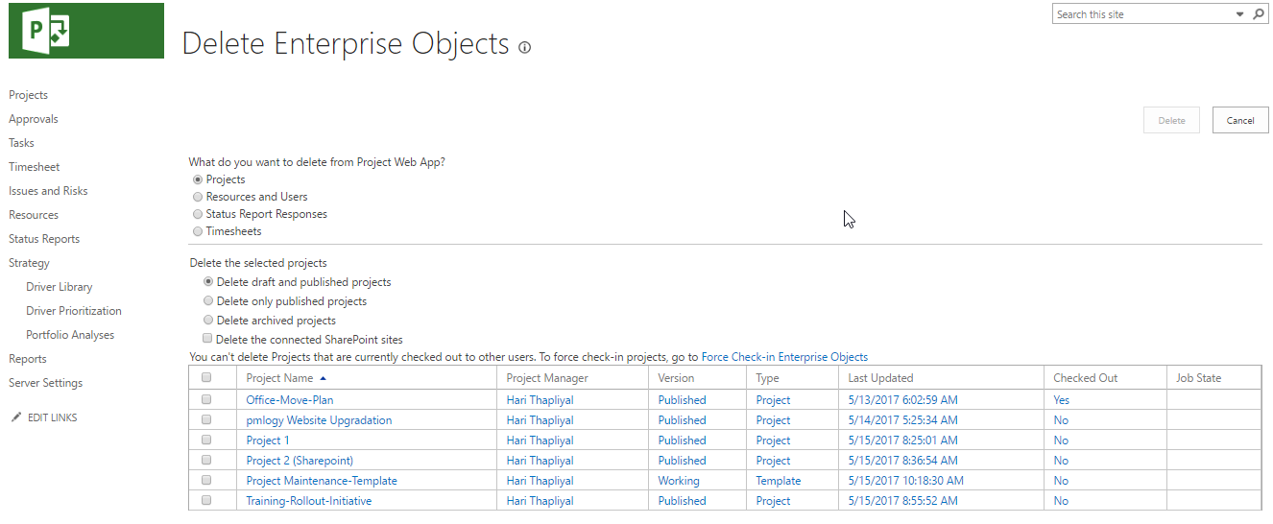
Delete Enterprise Objects

Slide 18
Enterprise Custom Fields (ECF)

Slide 19
What is ECF & Why they are needed

Slide 20
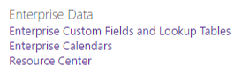
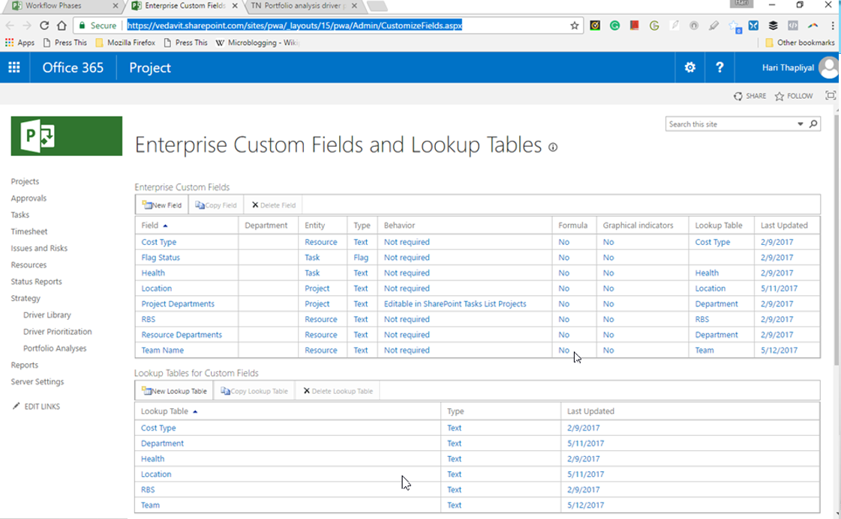
Enterprise Customer Fields & Lookup Tables

Slide 21
Enterprise Calendar

Slide 22
Resource Center

Slide 23
Project Templatization

Slide 24
Step1: Create Template Project Schedule

Slide 25
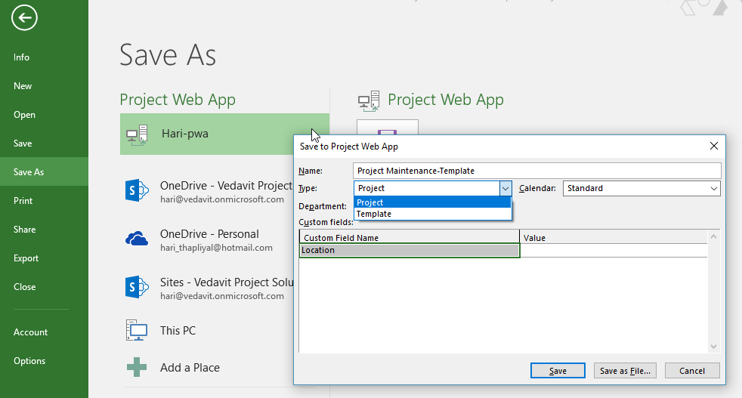
Step1: Saving Project Schedule as Template on Project Online from Project Professional 2016
Launch Project Professional Application on Local Machine
Create a project schedule
Save as template on local machine
Connect to PWA (Project Online)
Save on Server as Template

Slide 26
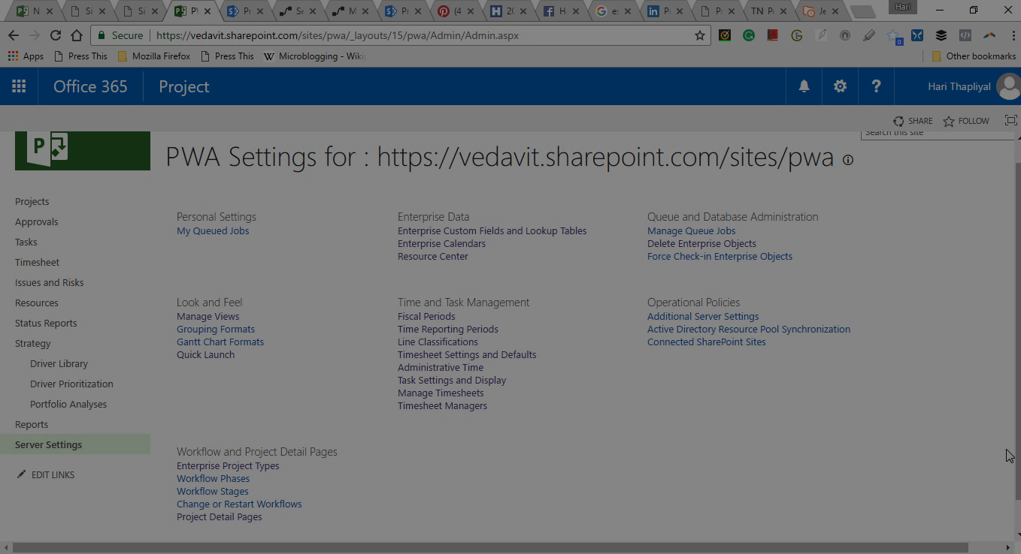
Step2: Project Detail Page

Slide 27
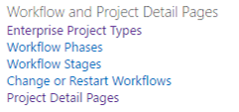
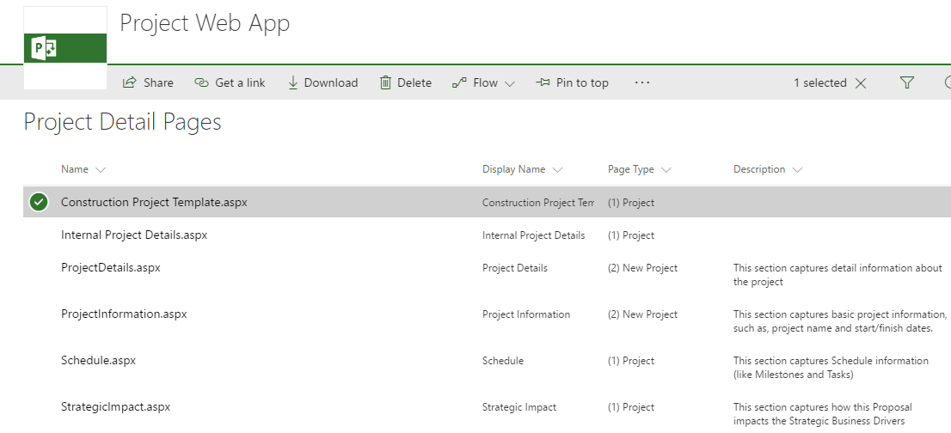
Delete Existing Project Detail Pages

Slide 28
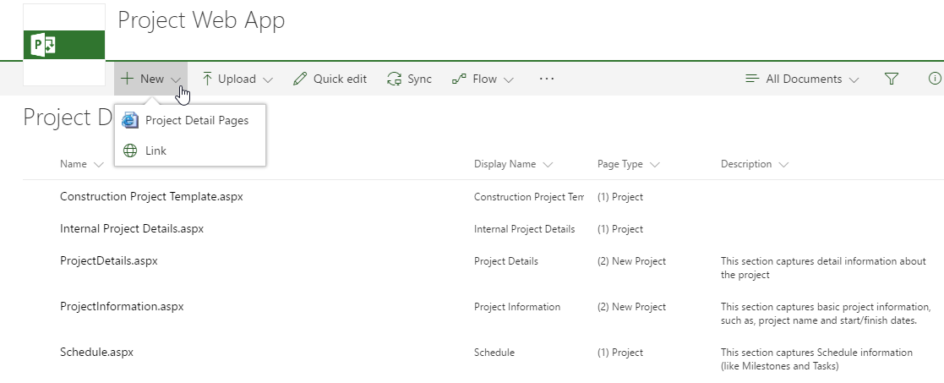
Create New Project Detail Page

Slide 29
Project Server 2016

Slide 30
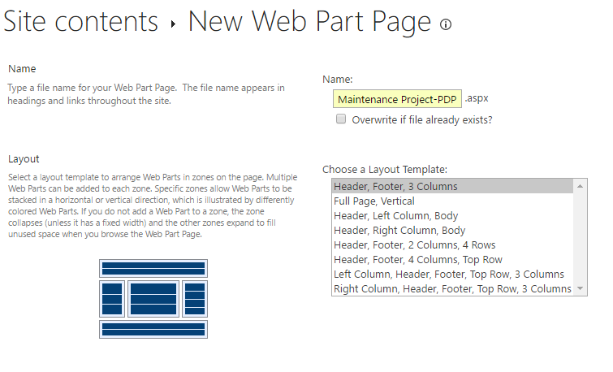

Slide 31
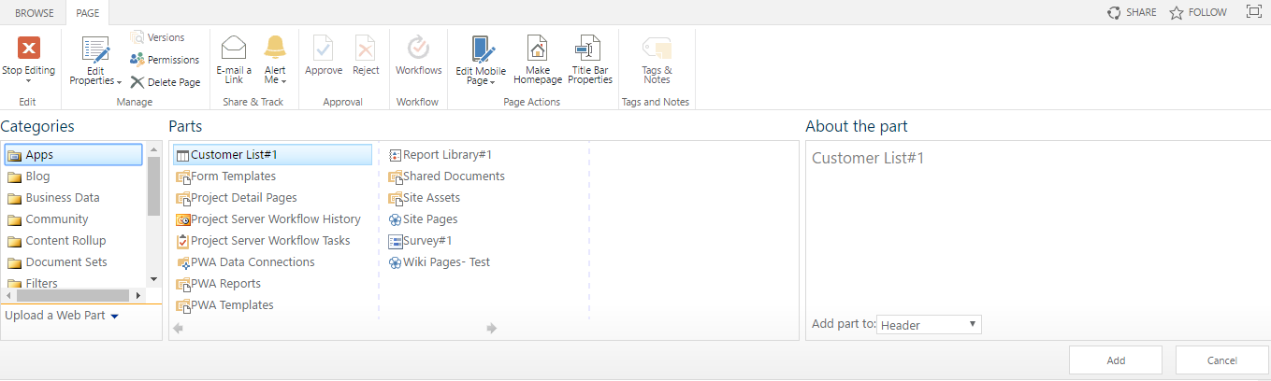
Category 1: Components for Project Detail

Slide 32
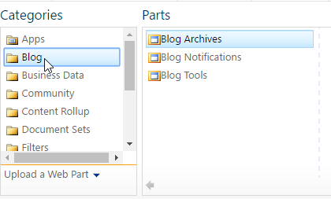
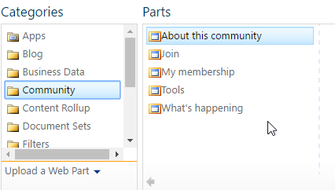
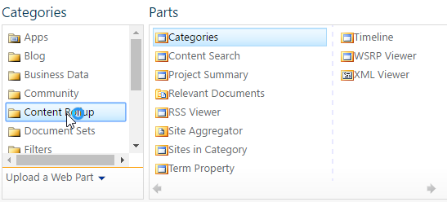
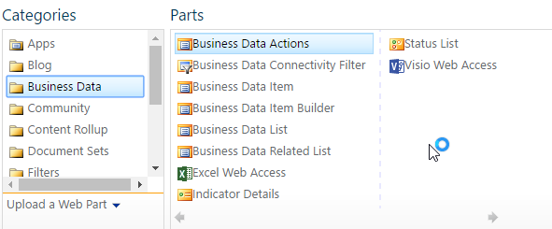
Category 2: Components for Project Detail

Slide 33
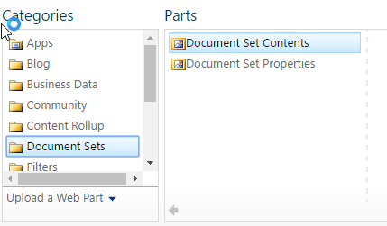
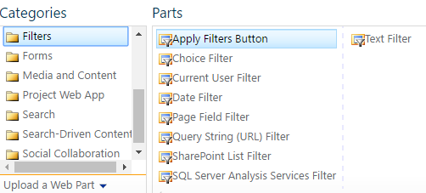
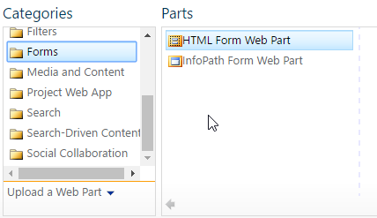
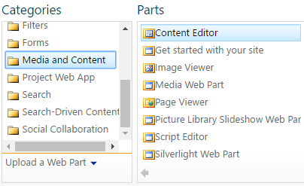
Category 3: Components for Project Detail

Slide 34
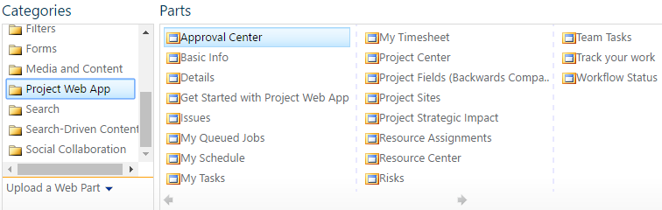
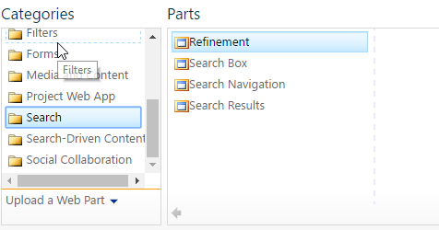
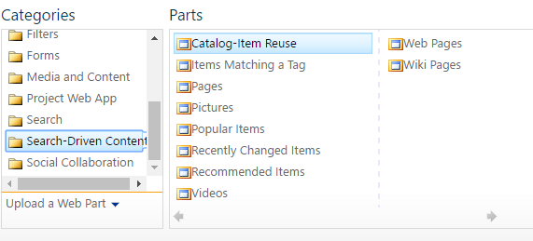
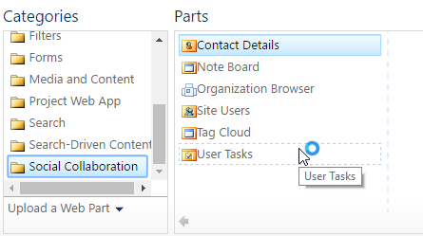
Category 4: Components for Project Detail

Slide 35
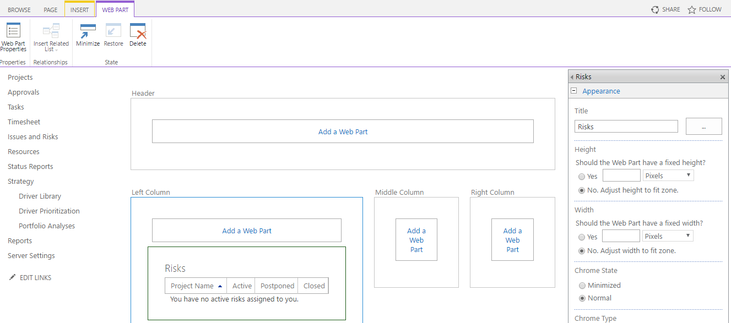
Editing Layout of Webparts in PDP

Slide 36
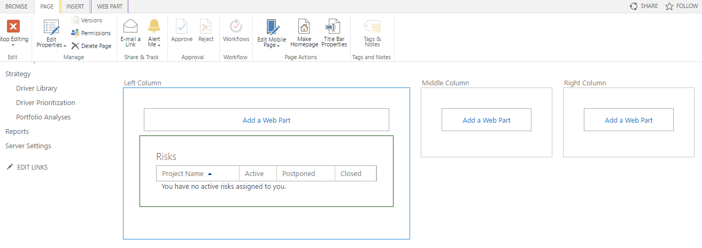
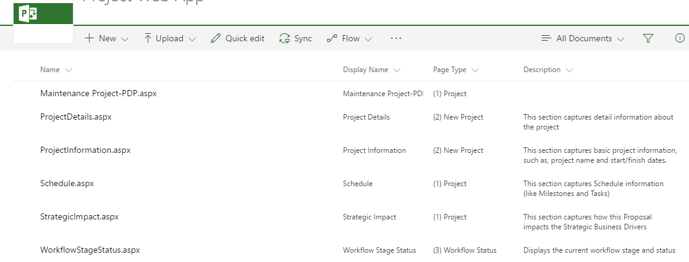

Slide 37
Steps
Step1: Saving Project Schedule as Template on Project Online from Project Professional 2016
Step2: Create Project Detail Page
Select few components (web-parts) for header. Body, footer of “Project Detail Page”
Step3: Create Enterprise Project Type

Slide 38
Step3: Create Enterprise Project Type

Slide 39
Project Server 2016

Slide 40
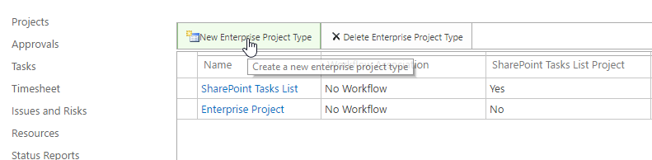
Enterprise Project Types

Slide 41

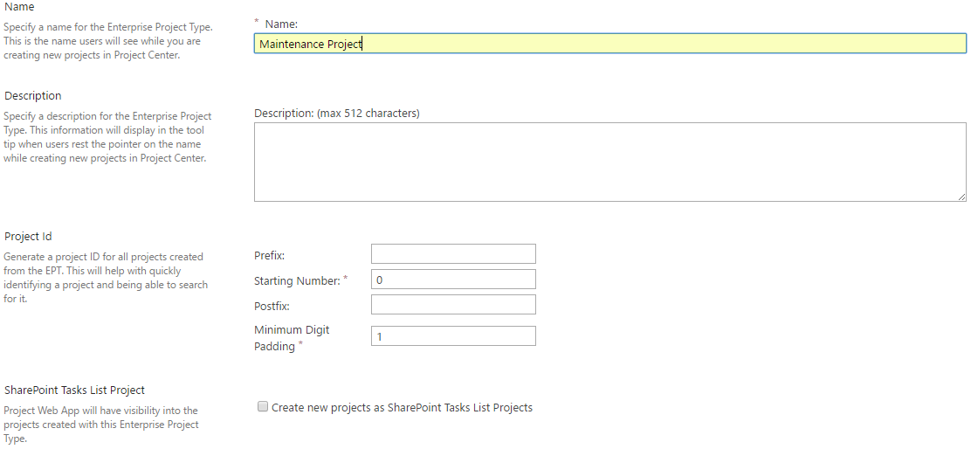
Add EPT

Slide 42
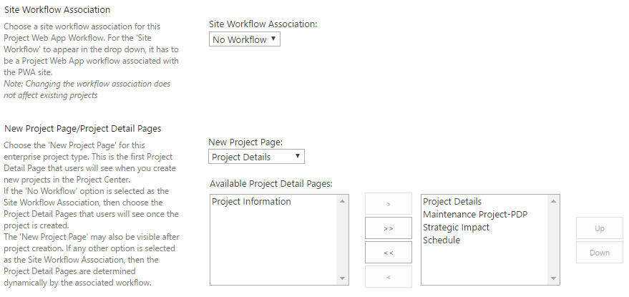
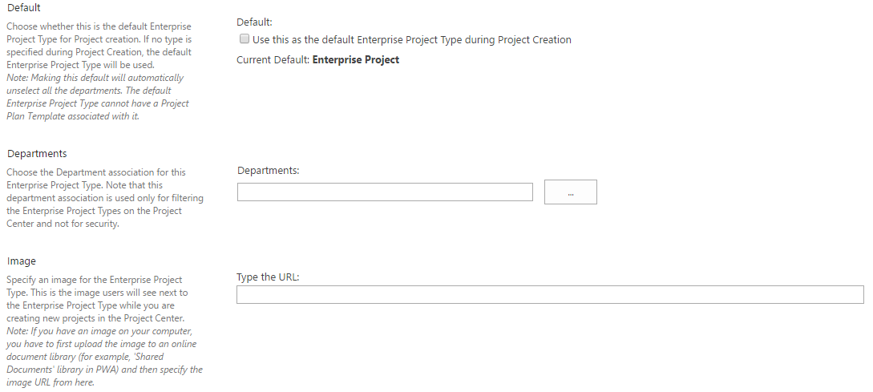
Add EPT Cont….
1
2

Slide 43
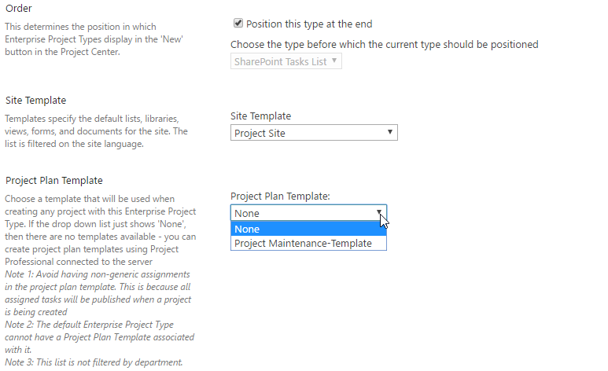
3
Select the Project Schedule which
you saved as template on Project Online

Slide 44
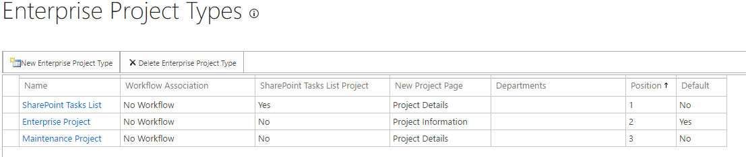
Enterprise Project Types

